Slide 1
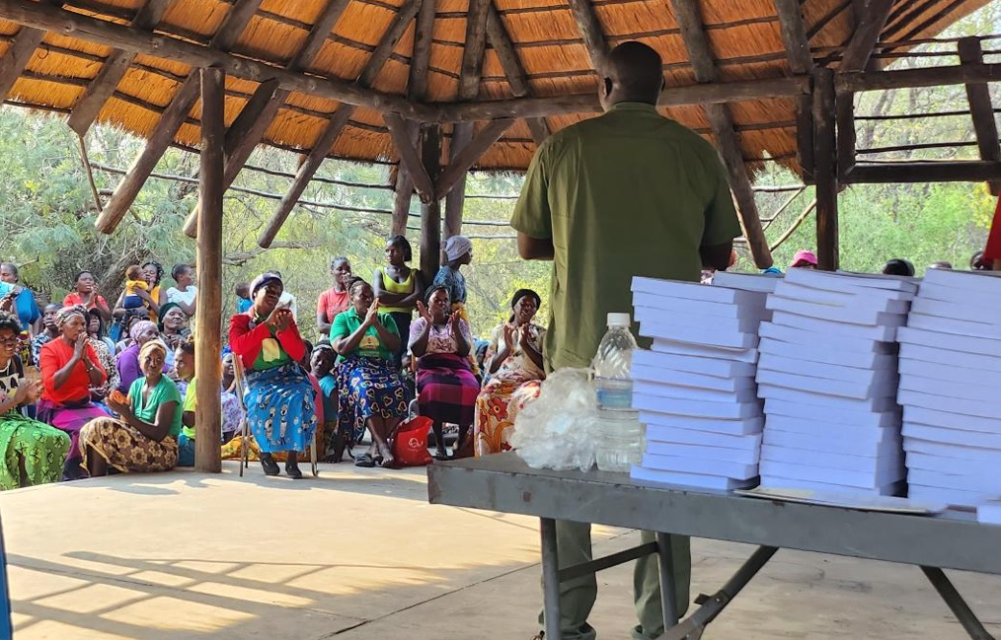
Completion Timeline Strategies

Slide 2

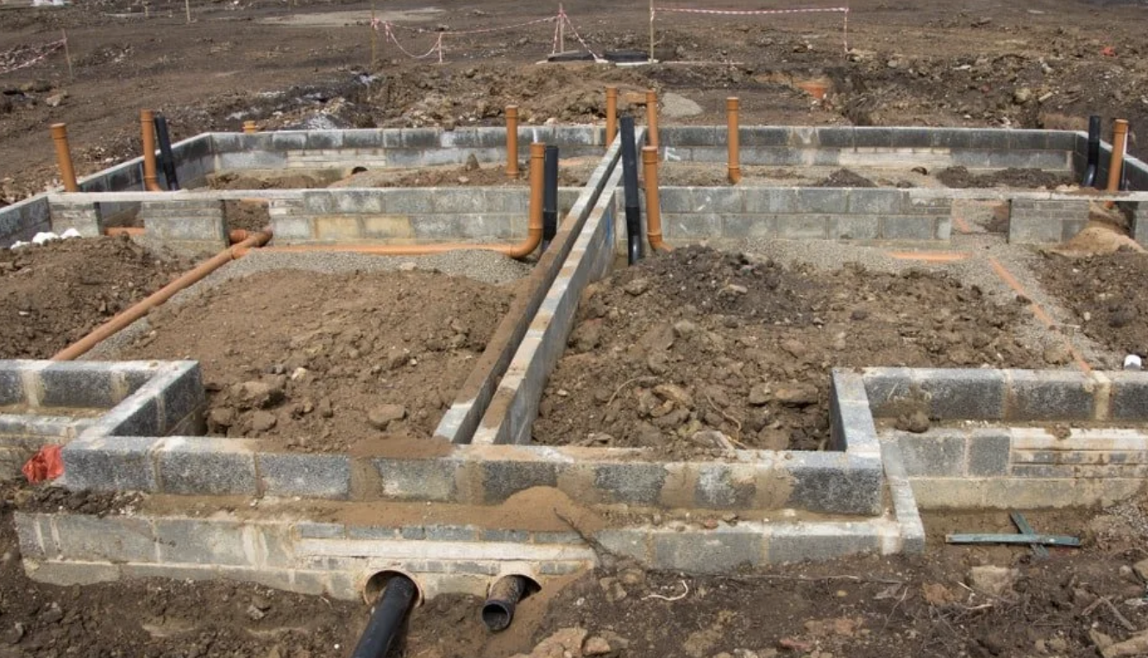


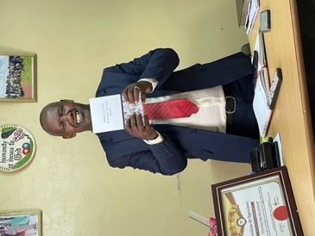
Planning with the End in Mind
Luke 14:28–30
Completion

Slide 3
?
Issues?
Resources?
Translators quit
Lost data
Broken technology

Slide 4
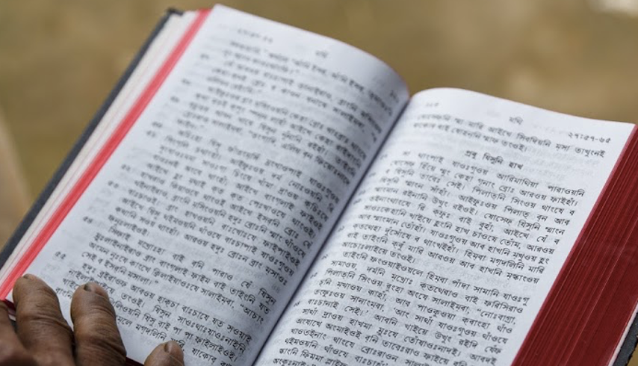

A New Testament in a Year?
8000 verses
➗ 52 weeks
= about 150 verses / week
➗ 5 translators
30
30
30
30
30

Slide 5


What will be your goal?
How many verses / week?
How many translators?
How will you meet?
How will you keep track?

Slide 6
?
How do you feel about this?
What can we do to help?

Slide 7
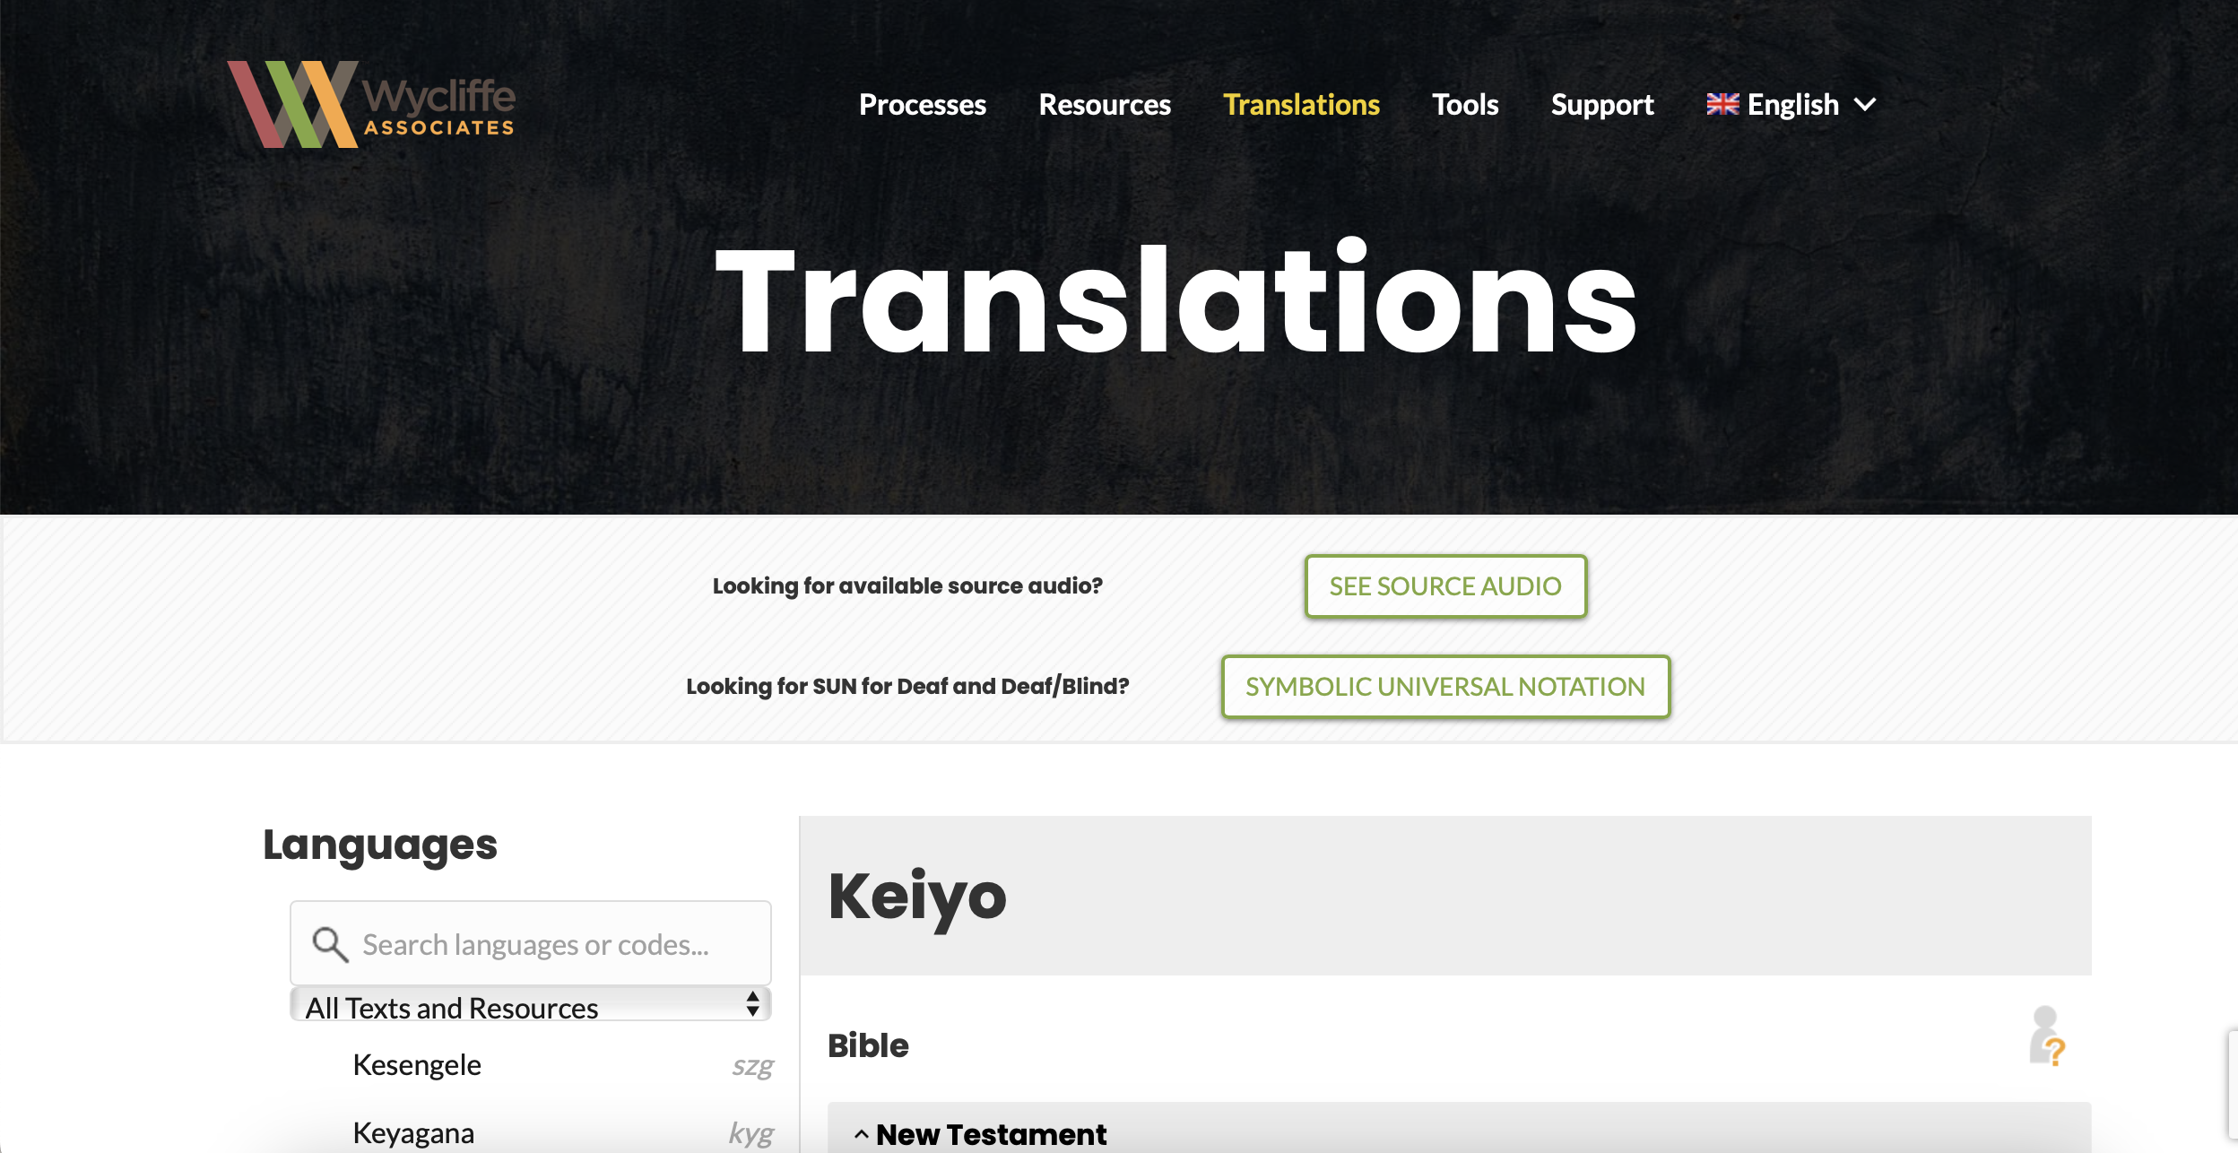
bibleineverylanguage.org

Slide 8


